Slide 1
TEAM 5 – RECRUITMENT AND TRAINING
By Michael Young (18050174) Josh Williams (18034055) Josh Medhurst (17131049) Ben Phillips (18034012)

Slide 2
INTRODUCTION
For the 3rd phase of the project we have been allocated different roles this includes:
Josh M as the Product Owner
Michael Y as the Leader
Ben P and Josh W as part of the Dev Team.
Being part of the Recruitment Team we were tasked with creating a Login System for Applicants to apply through. In this presentation we will be showcasing what we have created so far.

Slide 3
REQUIREMENTS
As the Recruitment and Training Team, we were tasked with creating a login system. Along with the system we created a database that would store the applicant details.
Applicants are required to answer a series of questions through multiple choice. Applicants who answer a certain amount of right questions will be added to the database to be interviewed.

Slide 4
Recruitment Questions Design
•The recruitment phase queries we ask the candidates will consist of digital literacy questions in a multiple choice format.
•For example: “You want to write a report on the future technology that is being developed, which of the following piece of software would be the most appropriate choice?
A. Microsoft PowerPoint
B. Notepad
C. Microsoft Word
D. Microsoft Excel”
•Candidates who score 5 or more in this test will be added to the list of successful candidates in the form of a text file.

Slide 5
PRODUCT
Demonstration

Slide 6
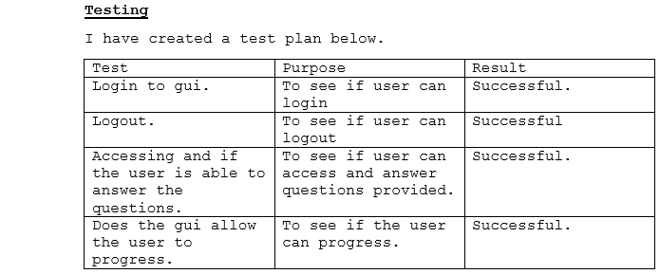
TESTING

Slide 7
Future Development
For the final product we will be implementing a training protocol to the program for the staff of the company.
This will include a comprehension on basic training topics, such as health and safety, fire safety and a digital literacy refresher.
We have not agreed upon a specific design yet, however this will be included in the final product.

Slide 8
ANY QUESTIONS?

